Slide 1

20 Years of Java
Story about her life
Notes:
This is a story about a girl called Java, and her life
now a grown up woman

Slide 2



Me, Myself and Java
ETF, FEIT, FINKI Eureka, Freelance, Genrep, Polar Cape
2002: Introduction with Java Portals (CMS), ETL, hibernate
EE since 2007 spring, j2ee, jsf
Current projects mobile hybrid apps (cordova, angularjs), test automation
JUGMK co-founder
Semos: Oracle Authorized Instructor
Notes:
This is my famous introductory slide
If you haven’t seen this one, then you really don’t know me ☺

Slide 3
Disclaimer
Based on true story
All characters appearing in this presentation are fictitious.
Any resemblance to real persons, living or dead, is purely coincidental.

Slide 4
Love…
1991
Star 7
1994
HotJava
1995
Java
1996
Oak
Applets
Green Team
Father
James Gosling
with the Green Team
Al Frazier, Joe Palrang,
Mike Sheridan, Ed Frank,
Don Jackson, Faye Baxter,
Patrick Naughton, Chris Warth,
Bob Weisblatt, David Lavallee
and Jon Payne
Notes:
All good stories begin with love, all good things are born out of love…
Do you recognize this guys?
They wanted a boy called Oak (extending C++)
Sun wanted to create some new tech consumer electronics
and a platform independent system (OS) to let them build large, distributed, heterogeneous network of electronics all talking to each other

Slide 5
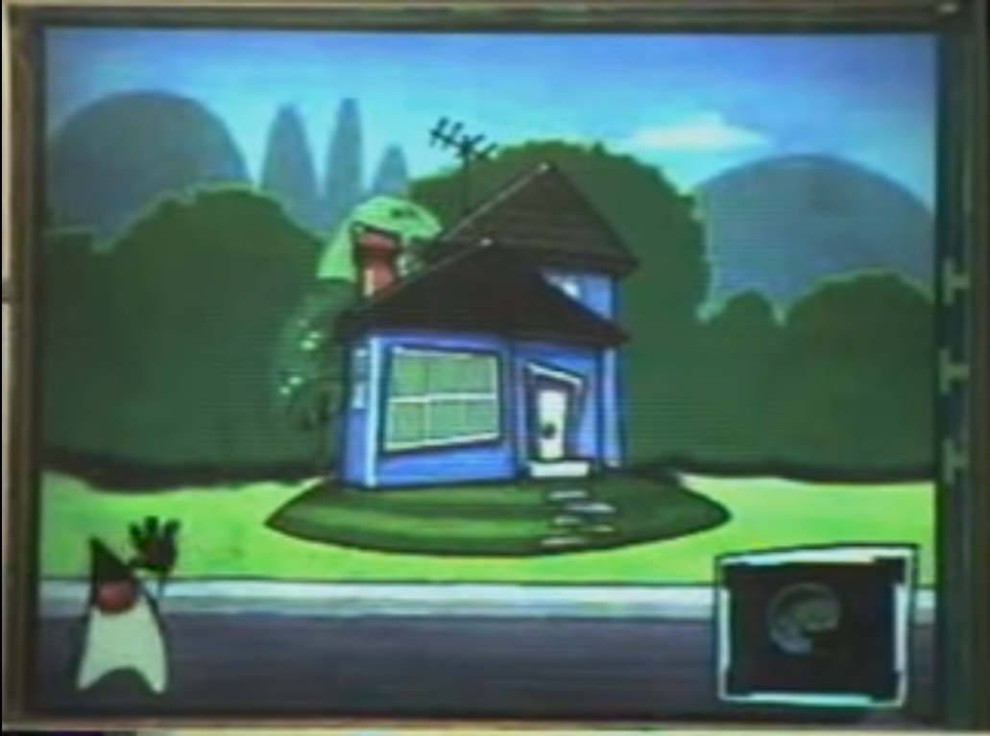
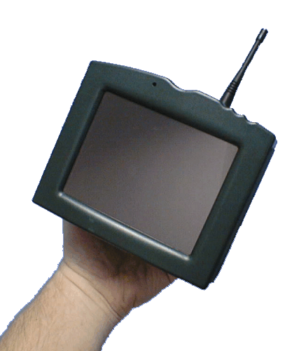
Pregnancy…
1991
Green Team
1994
HotJava
1995
Java
1996
Oak
Applets
Star 7
Expensive Toy – Star 7
Intended for Interactive TV and home entertainment
Animated Touch screen user interface
wireless networking, multimedia codecs, remote control (TV) …
Newly created language: Oak
Duke first appeared here as an assistant
https://www.youtube.com/watch?v=Ahg8OBYixL0
Notes:
Baby was conceived in 1992, and they started preparing some toys
Sun wanted to create some new tech consumer electronics
and a platform independent system (OS) to let them build large, distributed, heterogeneous network of electronics all talking to each other
But the market was not ready for this toys
Cable companies were scared of the change (interactivness)

Slide 6
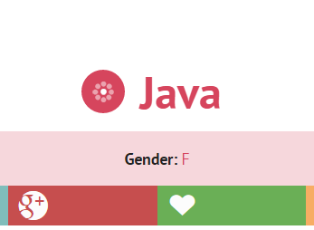
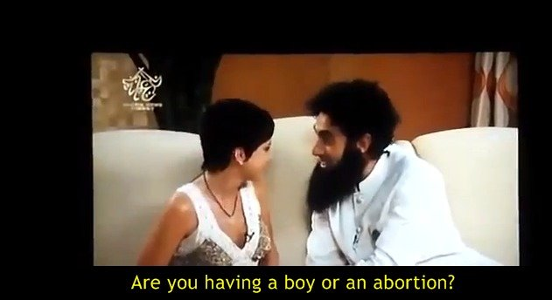
Birth…
1991
Green Team
1994
HotJava
1995
Java
1996
Oak
Applets
1992
Star 7
Birthday
It was a girl after all ☺
Renamed to Java (1995) according to nameberry.com
Kim Polese was the godfather
dynamic, revolutionary, lively, fun
Notes:
The initial project was failure?
Maybe the name was bad luck? ☺
'OAK' was already trademarked
The name represents something static, old, solid, strong
Netscape Navigator was released
http://www.javaworld.com/article/2077265/core-java/so-why-did-they-decide-to-call-it-java-.html
https://www.quora.com/Java-programming-language/What-are-some-unknown-facts-about-Java

Slide 7
Birth…
1991
Green Team
1994
HotJava
1995
Java
1996
Oak
Applets
1992
Star 7
HotJava graphical browser
First browser with moving objects
and dynamic executable content
Birth of Applet concept
First Java compiler written in Java
JVM is written in C
JRE (libraries) is written in Java
Native methods written in C/C++
JDK is written in Java
But, depends on the vendor…
Notes:
Meanwhile the internet was growing and many devices (browsers) got inter connected
This was exactly the purpose and design of the Java
The browser were very static: text and images.., Javascript is written in 95
So they wrote a browser using Oak
In 1994, a team of Java developers started writing WebRunner, which was a clone of the internet browser Mosaic

Slide 8
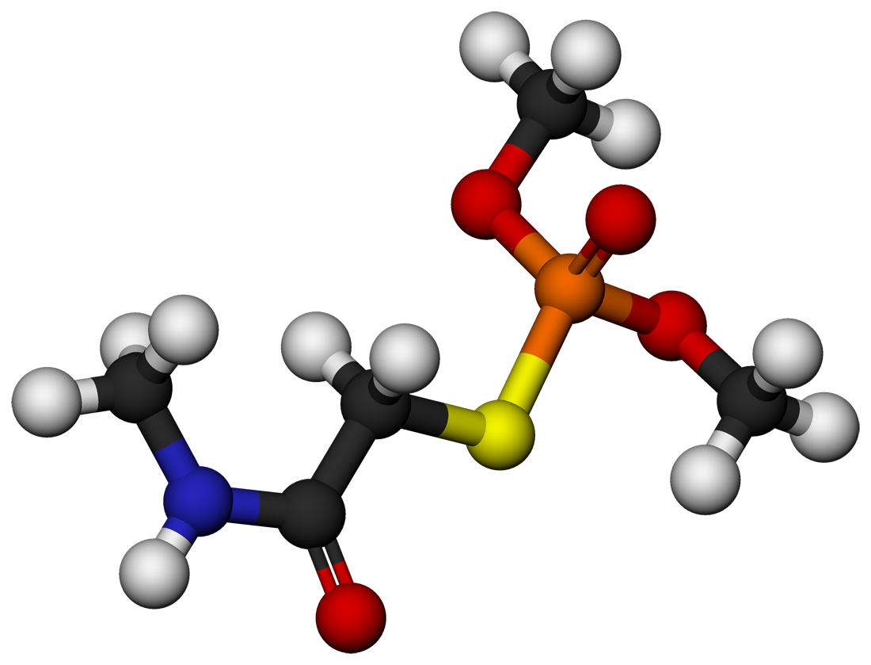


Toddler…
1991
Green Team
1994
HotJava
1995
Java
1996
Oak
Applets
1992
Star 7
First walk
TED Conference
Gosling prepared a demo for a 30 hours
3D molecule rotated using a mouse
WOW effect
First release
10 000 downloads in first months
Netscape browser includes Java support

Slide 9
Childhood…
1991
Green Team
1994
HotJava
1995
Java
1996
Oak
Applets
1992
Star 7
First JavaOne conference
6 000 attendees
Object-oriented Hype – rise of design patterns
Distributed Objects
Web Technologies
Notes:
Had rough childhood?
The hype landscape in 1992-1995…
–Object-orientation
•C++ not quite yet real
•Design Patterns rising in the hype-o-sphere
–Distributed Objects
•CORBA (Object Management Group)
•DOE (Sun)
•DCE (Open Group)

Slide 10
Primary Design Goals
Backwards Compatibility
code written for Java 1.0 will still compile on a Java 8
20 years later
Business is confident about stability
But progress is constrained?
Easy to Learn and Read
code is read more often than it is written (principle)
Overly verbose / repetitive code?
Code generators
Simple Type System
Primitive v.s. Object types
Everything is an Object
Single inheritance
Notes:
Type system (compromise and accident of history):
Performance of basic numerical operations was important
Automatic “boxing and unboxing” of primitive values to objects

Slide 11

Java definition
“A simple, object oriented, distributed, interpreted, robust, secure,
architecture - neutral, portable, high performance, multithreaded, dynamic language”
Lots of sandbox (Risky) concepts:
Garbage collection, Bytecode, JIT
Dynamic linkage, loading, introspection
Integrated thread support
Cross-platform memory model
Hybrid inheritance model
Unicode
Serialization
Notes:
TODO: explain each of these
Who thinks it’s Simple?
Goals:
To provide a container for simple execution of object-oriented application code
To remove tedious bookkeeping from the hands of developers and make the platform responsible for accounting for memory
To remove C/C++ platform security vulnerabilities wherever possible
To allow cross-platform execution

Slide 12
Java definition
But very Safe - The risky stuff is mostly in the VM
No pointers
Null and array bounds checks
Runtime verification
Back-compatibility
And Simple - Excluded YAGNI (You Aren’t Gonna Need It):
Operator overloading, macros,
typedef, struct, union, enum,
function pointers, multiple inheritance,
automatic coercions
Notes:
TODO: explain each of these
The YAGNI stuff is mostly in the language

Slide 13
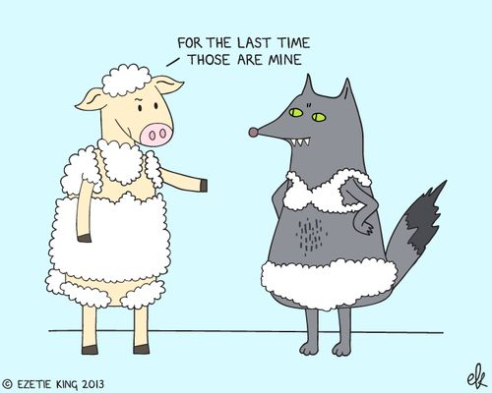
A Wolf in Sheep’s Clothing
“It was clear from talking to customers that they all needed
GC, JIT, dynamic linkage, threading, etc,
but these things always came wrapped in languages that scared them.”
– James Gosling in private communication with Brian Goetz

Slide 14

Puberty…
2004
Java 5
2006
Open Source
2007
JavaFX
2010
Tiger
Java SE 6
2005
Java Champions
Teenage days
Java 5 features
Generics
enums
annotations
autoboxing
More popular
7m JVM downloads, 1.5b devices, 7m web pages
Mars Rover (Spirit)
Verified for mobility
First Multiplayer game
Open source negotiations
Notes:
Generics: flexible type safety to your code
Enums: typesafe class variations that Provide a compile-time range check
Annotations: syntactic additional metadata of the source code
Autoboxing: make sensible assignments without formal casting syntax

Slide 15


It’s time for … Java = Coffee?
What’s the deal with this Coffee thing?
CSS = Coffee Style Sheet?
Let’s create a GreenTea fork
Notes:
How many don’t drink coffee?
Our design team spends most of the coffee
CSS = Coffee Style Sheet?
Let’s create a GreenTea

Slide 16
Puberty…
2004
Java 5
2006
Open Source
2007
JavaFX
2010
Tiger
Java SE 6
2005
Java Champions
Time to make friends and share
OpenJDK – open source JDK
JCP (1998)
bring potential rivals “inside the tent”
Technology Compatibility Kit (TCK) was not opened
Apache Harmony, later Google Android
Licensing issues
Big dreams (for Java 7)
Lambda (functional)
Modules
New Garbage Collector (G1)
Support for non-Java languages in JVM

Slide 17
College…
2010
Oracle
2013
Java EE 7
2014
Java SE 8
2015
2011
Java SE 7
Lambda
Java Goes to University ☺
Oracle acquires Sun
The Father leaves
Bad critics from the community
Oracle sued Google for copyright (Android)
Apache leaves JCP (TCK)
Notes:
Sun’s revenue and profits were in serious trouble, and Sun’s Board began to seek buyers for the business

Slide 18
Graduation…
2010
Oracle
2013
Java EE 7
2014
Java SE 8
2015
2011
Java SE 7
Lambda
But, Oracle is still interested in Java .. No Worries
Java 7 released (small fixes and improvements)
Type inference (generics), Multicatch
Java EE 7 released
HTML5, WebSocket, JSON, Web Profile, JAX-RS 2, Servlet 3.1
Java 8 released
Lambda expressions
Default (interface) methods
Multiple inheritance, but only of implementation
Notes:
TODO: add examples of lambda?
Previously, Java developers had been forced to use anonymous classes as a verbose substitute
evolve Java’s collections to allow support for “more functional” operations, such as map and filter
This can be a backwards compatibility issue, so different path is
allowing an interface to specify a default implementation for new methods
Java’s model of objects changes, to allow multiple inheritance, but only of implementation

Slide 19
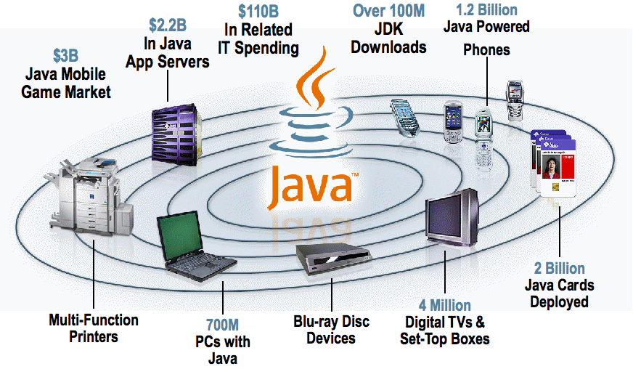
20 Years Later…
2015
Birthday
2017
2016
Java SE 9
Modules
Java EE ver. 8
2018
Celebrity
Java is everywhere
97% of enterprise desktops
community of over 9M devs

Slide 20
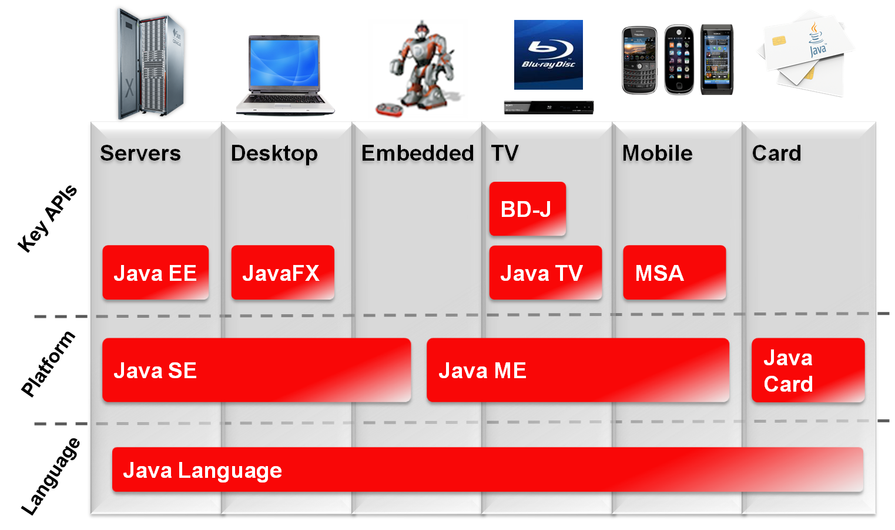
20 Years Later… Technology Groups
2015
Birthday
2017
2016
Java SE 9
Modules
Java EE ver. 8
2018

Slide 21
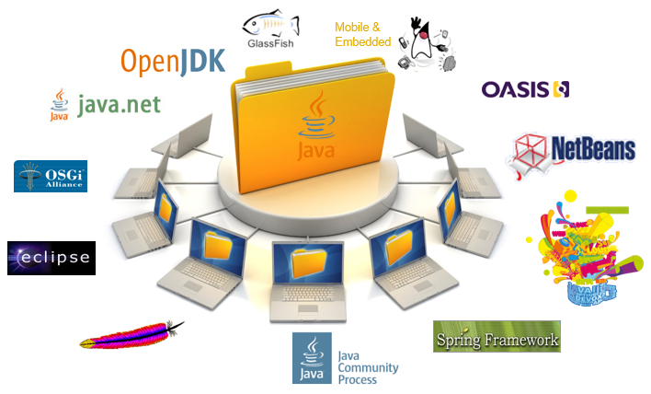
20 Years Later… Community
2015
Birthday
2017
2016
Java SE 9
Modules
Java EE ver. 8
2018

Slide 22
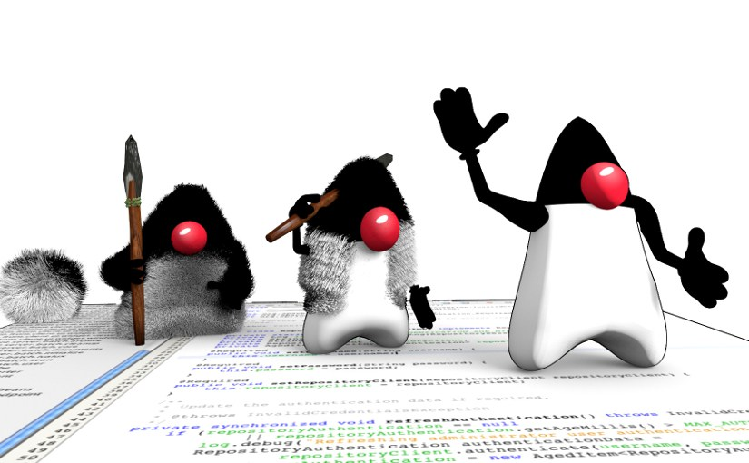
20 Years Later…
2015
Birthday
2017
2016
Java SE 9
Modules
Java EE ver. 8
2018
Teenage days are over
Java now mature / stable
The parents are proud
Java passed the test of time
Great design, ahead of time
Time to grow up (evolve)
Functional Programming
Modules
The second age of Java

Slide 23

Near Future
2015
Birthday
2017
2016
Java SE 9
Modules
Java EE ver. 8
2018
Java SE 9 (2016)
Modularity (finally)
New packaging of the archive
Access control across modules
Garbage First (G1)
Users set “pause goals”
Available since Java 7, but not default
HTTP/2 API change
JShell (project Kulla): Read-Evaluate-Print-Loop (REPL) tool.
Money and Currence API
Java EE 8 (2017)
HTML5
Cloud
MVC
Security

Slide 24
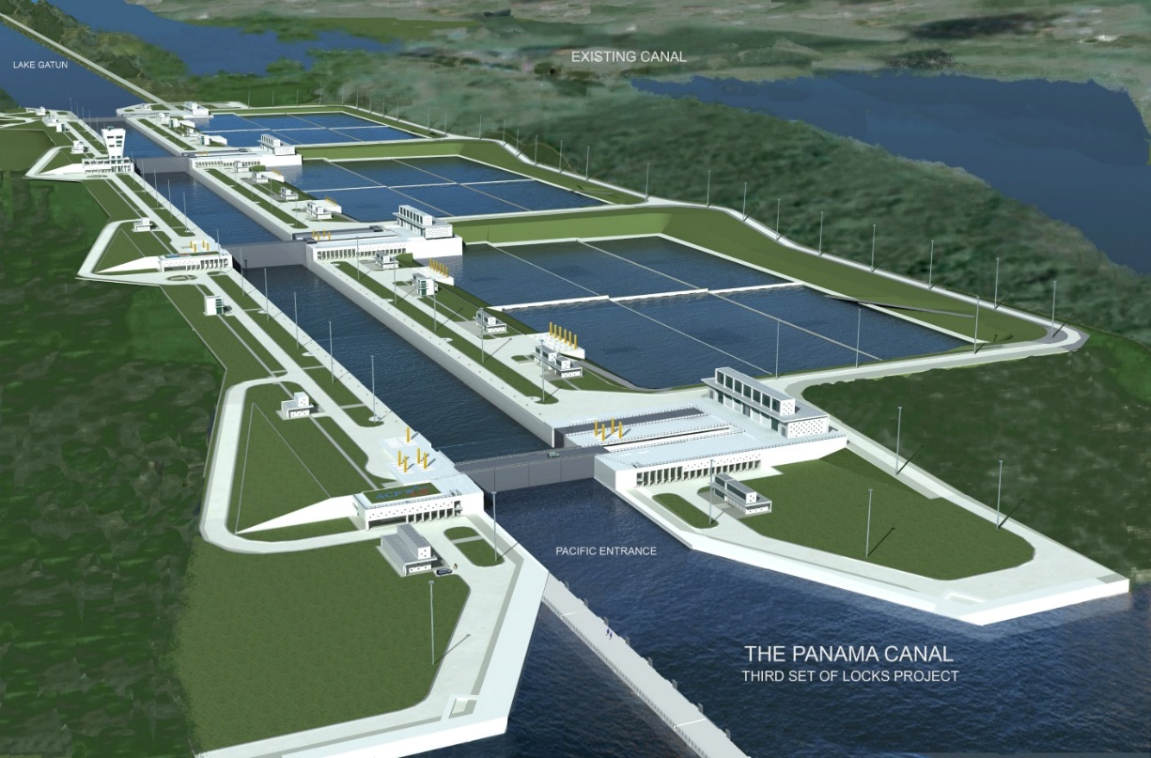
What’s Next
2015
Birthday
2017
2016
Java SE 9
Modules
Java EE ver. 8
2018
Project Panama
Foreign Function Interface (FFI) for the JVM
bridge between Java and C/C++
Replace Java Native Interface (JNI)
Project Valhalla
Value Types
Enhanced Generics
Use primitives: List <int>
Internet of Things (IoT)
Connect different devices using Internet
Issues: security, bandwidth, data handling
Notes:
Panama
evolve Java’s access to native code without sacrificing that safety is a major undertaking
http://www.infoworld.com/article/2607953/java/article.html
http://phatak-dev.github.io/techtalks/the-evolution-of-java/
http://www.javacodegeeks.com/2014/03/java-facts-to-blow-your-mind.html

Slide 25
Integration with other languages
BeanShell - A lightweight scripting language for Java.
Clojure - A dialect of the Lisp programming language.
Groovy - a dynamic language with features similar to those of Python, Ruby, Perl, and Smalltalk.
JRuby - A Ruby interpreter.
Jython - A Python interpreter.
Kotlin - An industrial programming language for JVM with full Java interoperability.
Rhino - A JavaScript interpreter.
Scala - A multi-paradigm programming language designed as a “better Java”.
Gosu - A general-purpose Java Virtual Machine-based programming language released under the Apache License 2.0.
DukeScript – technology for creating cross-platform mobile, desktop and web apps

Slide 26

Jobs
Java is a blue collar language. It’s not PhD thesis material but a language for a job.
—James Gosling
Top Happiest Jobs for the Class of 2014:
Java developer
Embedded software engineer
.NET developer
2011-2014 Analysis by careerbliss: 25.000+ anonymous employee reviews

Slide 27
Jobs - Today
In total, search term "Java"
86.000+ Java jobs on indeed
Seniors 27.000+, Architects 12.000+
NY 6.000+, SF 3.700+, Seattle 3.000+
Amazon 2.000+, TEKSystems 1.500+, CyberCoders 1.200+
158.000+ Java jobs on SimplyHired
Seniors 55.000+
NY 16.000+, SF 15.000+
Oracle 12.000+, Walmart 2.100+, CyberCoders 2.000+
18500+ Java jobs in NY on glassdoor
SF 12.800+

Slide 28
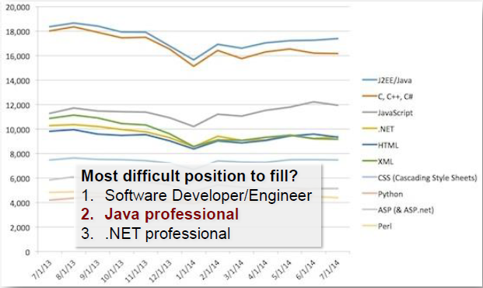
Jobs at Dice.com - jobs post request by skill per month

Slide 29
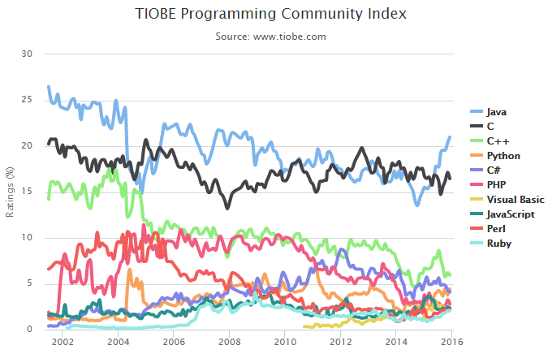
December Headline Java's popularity is going through the roof

Slide 30
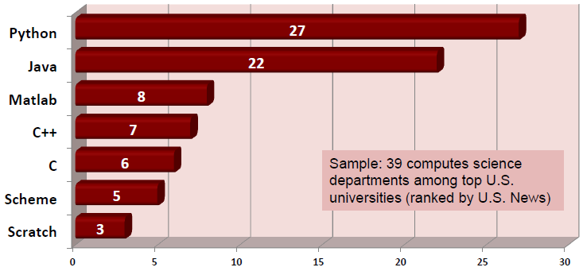
Java Education
Top programming languages at introductory programming courses in USA

Slide 31
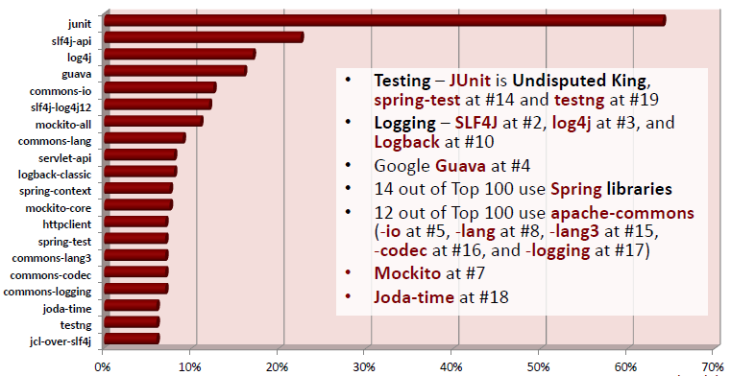
Java libs on github.com

Slide 32
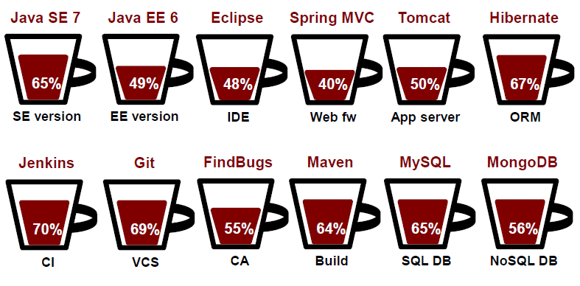
What was used in 2014?

Slide 33
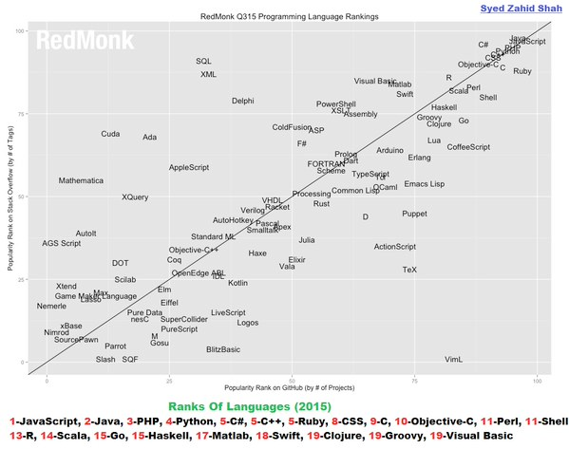
Java Popularity – GitHub & StackOverflow

Slide 34
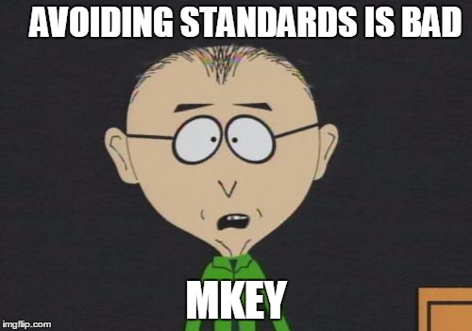
Get involved, Make a Change
Standards
Language is one of them, currency, etc.
They hanged people before for not following standards
Should be open
JCP – Java Community Process
mechanism for developing standards
technical specifications for Java
Join the community
JSR
descriptions of proposed specifications
final specifications for the Java platform
Adopt a JSR
https://adoptajsr.java.net/
Notes:
Modern times
Railways forced the standardization of time tables
Interchangeable parts -lead to mass prod
Computer age
It all started with cards
The first standards war: tesla vs edison
Everyday life standards
Beer, clothes, chocolate, music tuning, color,
Disaster strikes. If no standards
Mars orbit 1999
Standards - def
De facto vs de jure
decided by market competition v.s. established by formal standard bodies (ISO)
Should be open
Not same as open source
No vendor lock in (ibm)

Slide 35

Get involved, Make a Change
JUGMK
official group of Java users since 2008
share ideas, experiences and knowledge
regular meetings
Every second Wednesday @ 18:00
technical conferences
Small tech meetups
Big One Day Conference
Today: Two tracks
Join Us
Google Group, Twitter, GitHub, Facebook http://jug.mk/contact/

Slide 36
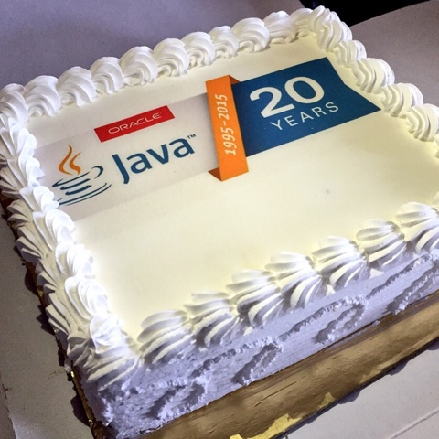
Java Legend
Java is still not a Legend, it has just started living, let us all help it become a Legend, and ourselves part of it
Happy Birthday, Java!

Slide 37
Questions?
Thank You! twitter: @spesov stojan.pesov@gmail.com
References:
2015, Java: The Legend - by Ben Evans
2015, Expansion of Java Community – by Branko Mihaljević, Aleksander Radovan (HUJAK)
2014, Java Past, Present, and Future – by Brian Goetz
2015, Java Timeline – by Oracle

